Slide 1
Data visualization
BMS270: Applied biostatistics
24/05/2022
Abel Torres Espín, Ph.D.
Brain and Spinal Injury Center (BASIC)
Department of Neurological Surgery
University of California, San Francisco (UCSF)

Slide 2
Plan:
Why data visualization in a statistics course?
Different use of data viz
The grammar of graphics and ggplot2

Slide 3
Why data visualization in a statistics course?
“there is no statistical tool that is as powerful as a well-chosen graph”
Chambers, Cleveland, Kleiner and Tukey (1983)

Slide 4
Why data visualization in a statistics course?
“there is no statistical tool that is as powerful as a well-chosen graph”
Chambers, Cleveland, Kleiner and Tukey (1983)

Slide 5
Why data visualization in a statistics course?
“there is no statistical tool that is as powerful as a well-chosen graph”
Chambers, Cleveland, Kleiner and Tukey (1983)

Slide 6


Why data visualization in a statistics course?
“there is no statistical tool that is as powerful as a well-chosen graph”
Chambers, Cleveland, Kleiner and Tukey (1983)
You have a superpower

Slide 7
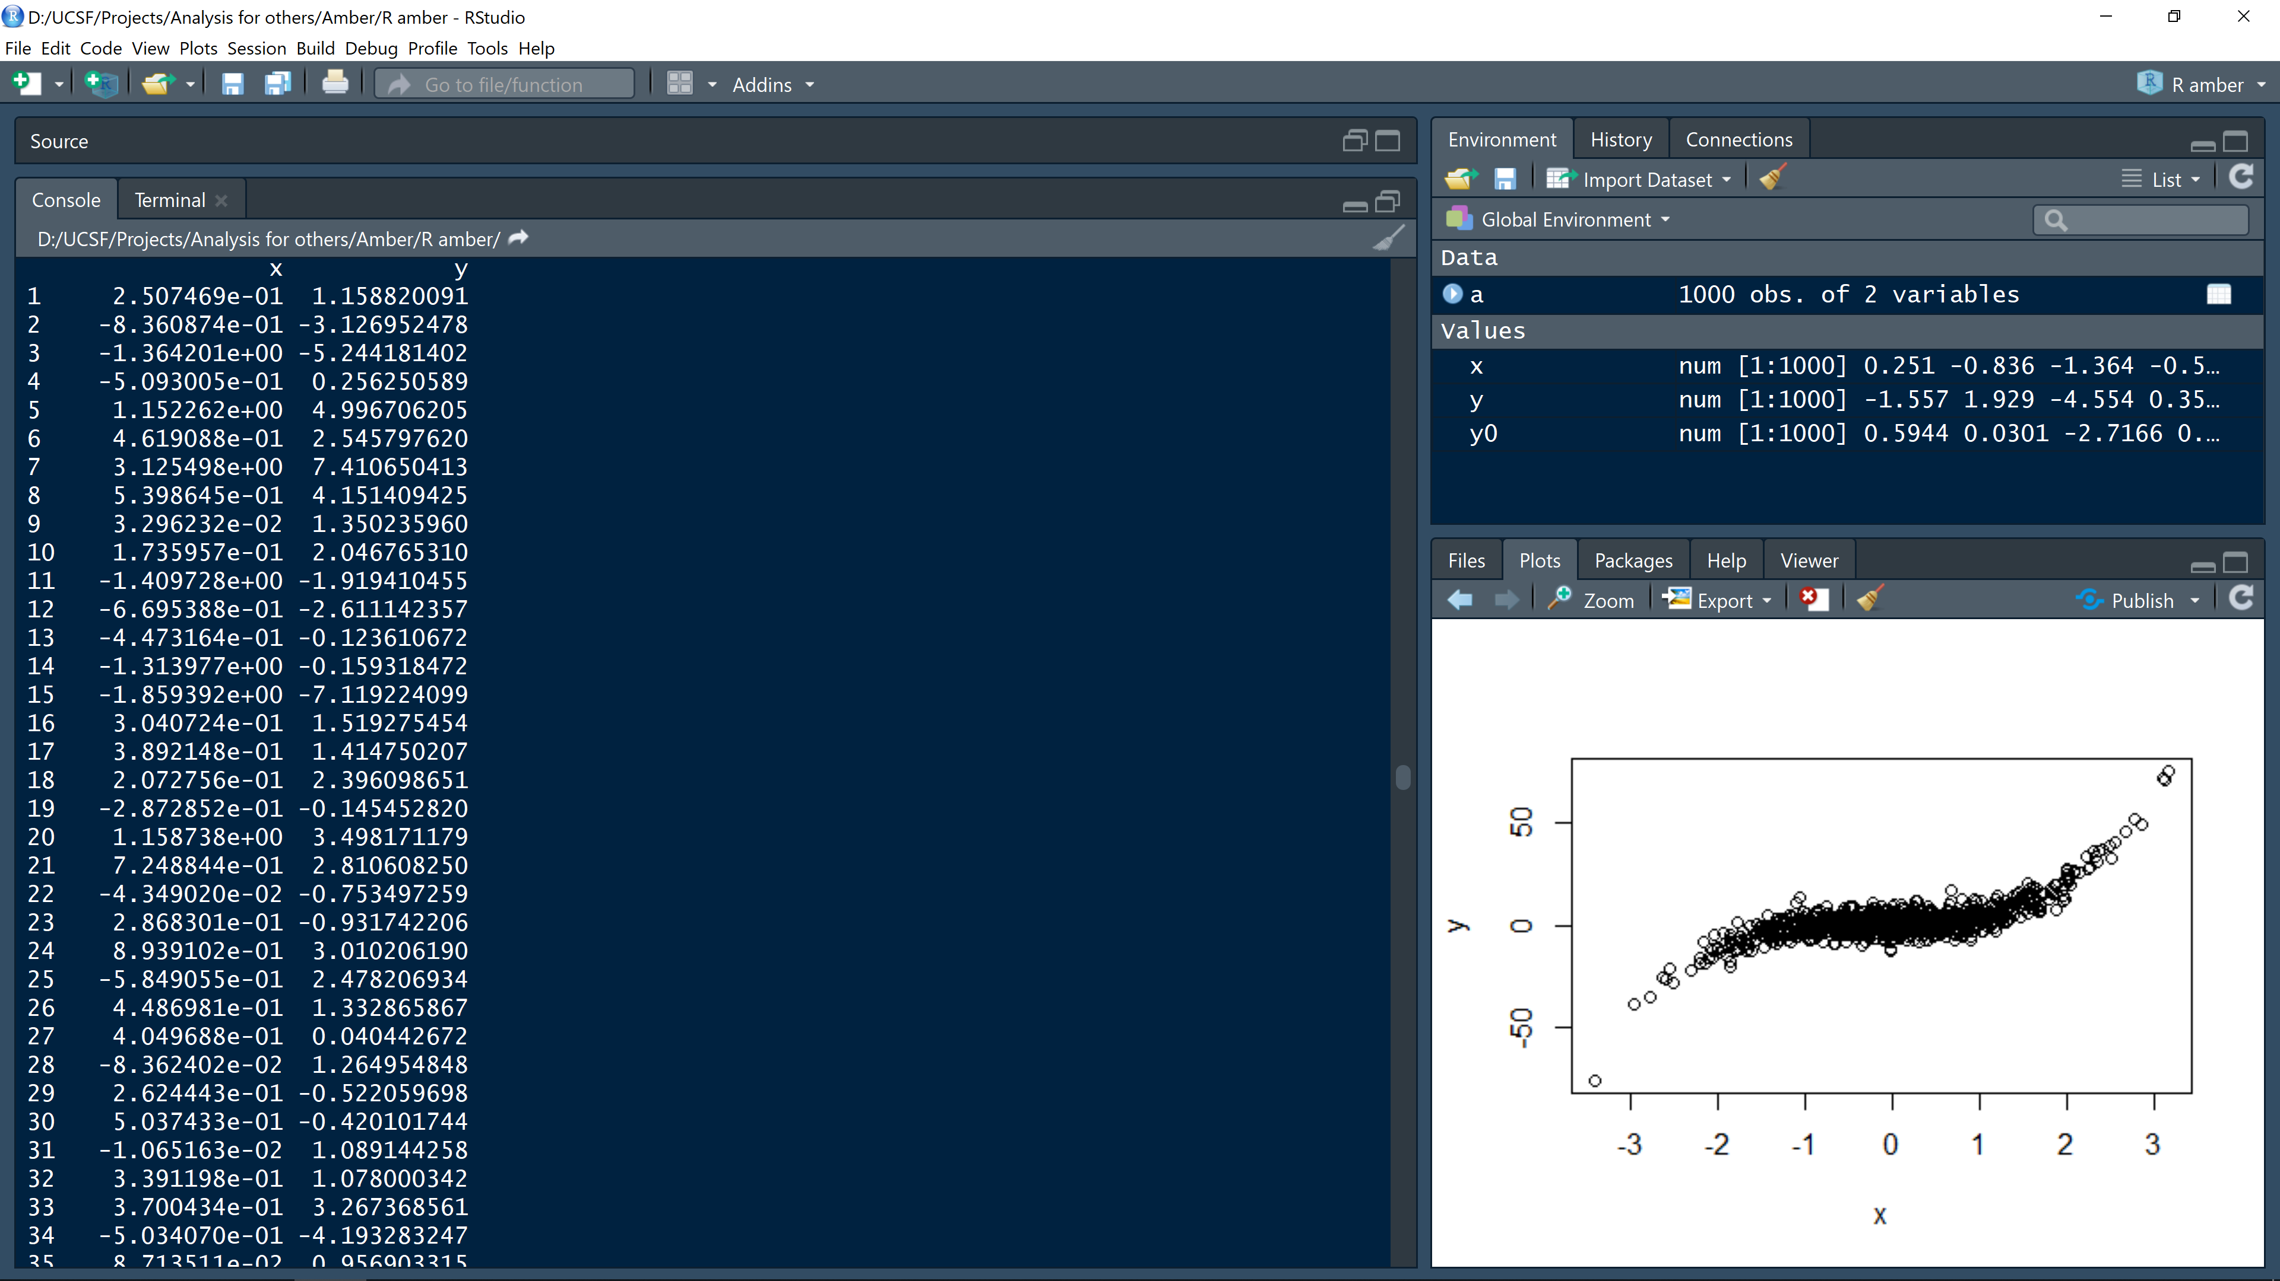
Why data visualization in a statistics course?
“there is no statistical tool that is as powerful as a well-chosen graph”
Chambers, Cleveland, Kleiner and Tukey (1983)
Humans are really good at recognizing visual patterns

Slide 8
Why data visualization in a statistics course?
“there is no statistical tool that is as powerful as a well-chosen graph”
Chambers, Cleveland, Kleiner and Tukey (1983)
Humans are really good at recognizing visual patterns

Slide 9


Slide 10
Why data visualization in a statistics course?
“Humans are good at discerning subtle patterns that are really there, but equally so at imagining them when they are altogether absent”
Carl Sagan (Contact)

Slide 11
Why data visualization in a statistics course?
“Humans are good at discerning subtle patterns that are really there, but equally so at imagining them when they are altogether absent”
Carl Sagan (Contact)
With a great power comes a great responsibility
(Uncle Ben)

Slide 12
Why data visualization in a statistics course?
“Humans are good at discerning subtle patterns that are really there, but equally so at imagining them when they are altogether absent”
Carl Sagan (Contact)
With a great power comes a great responsibility
(Uncle Ben)
Should we plotting data?
What data should be plot?

Slide 13
Why data visualization in a statistics course?
“Humans are good at discerning subtle patterns that are really there, but equally so at imagining them when they are altogether absent”
Carl Sagan (Contact)
With a great power comes a great responsibility
(Uncle Ben)
Should we plotting data?
What data should be plot?
What is the problem?

Slide 14


Slide 15

We can not unsee
https://www.theatlantic.com/technology/archive/2014/05/10-things-you-cant-unsee-and-what-that-says-about-your-brain/361335/

Slide 16
Why data visualization in a statistics course?
Explore data: To provide an overview and/or to suggest hypothesis
Diagnostic plots: To criticize a model
Communicate: To tell a story

Slide 17
“Data graphics visually display measured quantities by means of the combined use of points, lines, a coordinate system, numbers, symbols, words, shading and color”
Tufte (1983)

Slide 18
2. Exploring data with plots
Check for errors
Data structure
Explore/describe your data to get insights
They don’t need to be pretty but they need to be useful, informative and truthful!

Slide 19
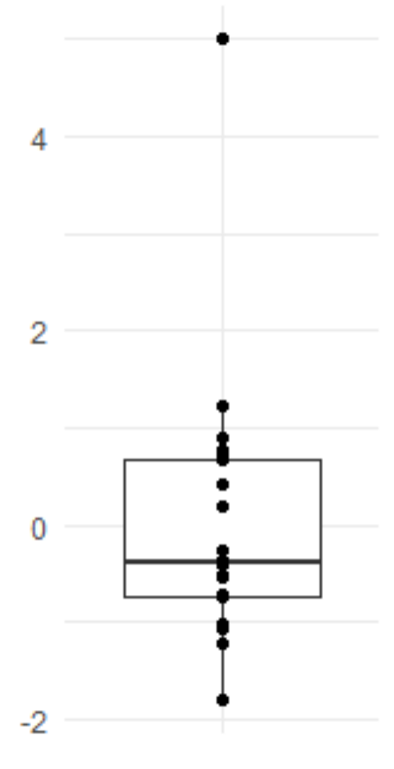
Real value: consider outlier
Data entry typo
Wrong formula
?

Slide 20
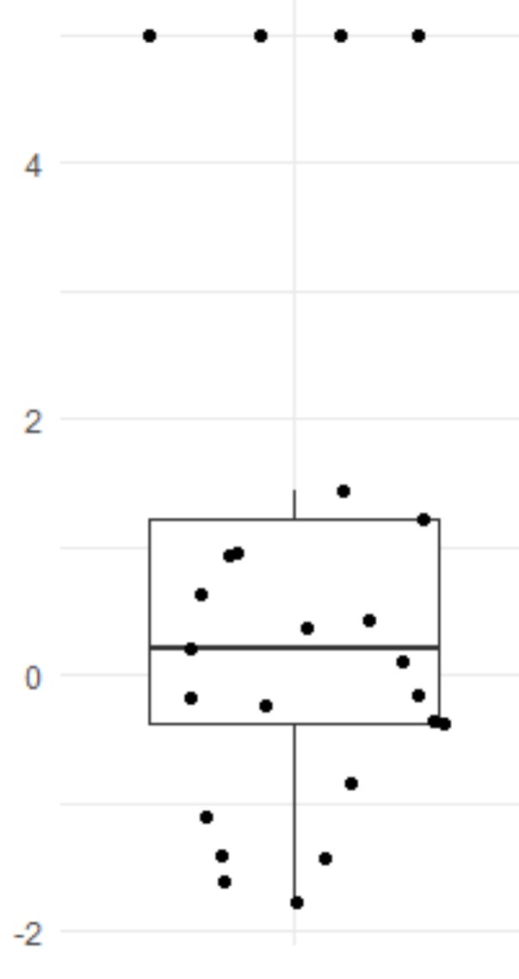
Real value: consider outlier
Data entry typo
Wrong formula
?
Data Duplication?

Slide 21
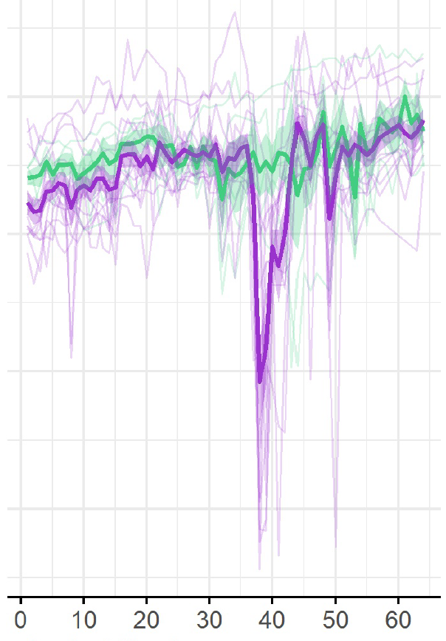
Real value: consider outlier
Data entry typo
Wrong formula
?
What happen here?
Data Duplication?
Data collection failure

Slide 22
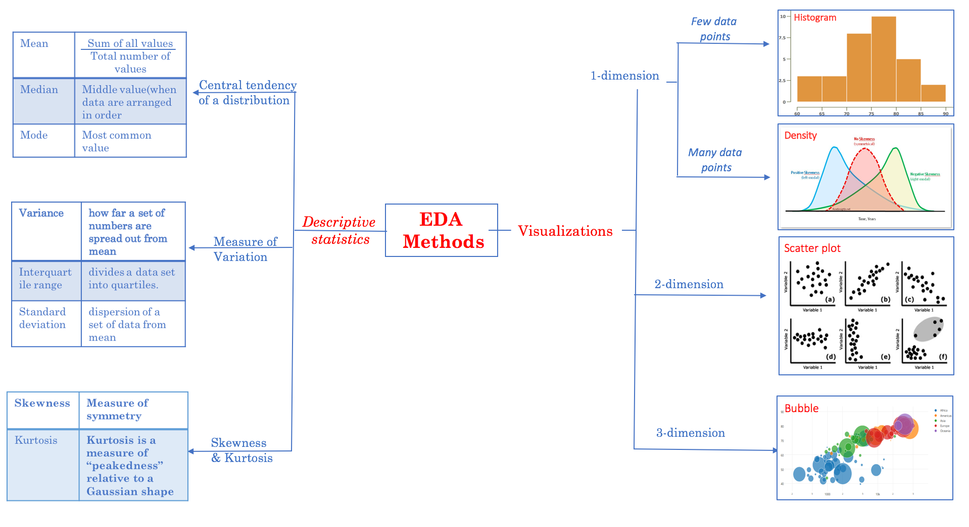
Exploratory data analysis (EDA). John W. Tukey in 1977
http://www.jeannjoroge.com/significance-of-exploratory-data-anaysis/

Slide 23
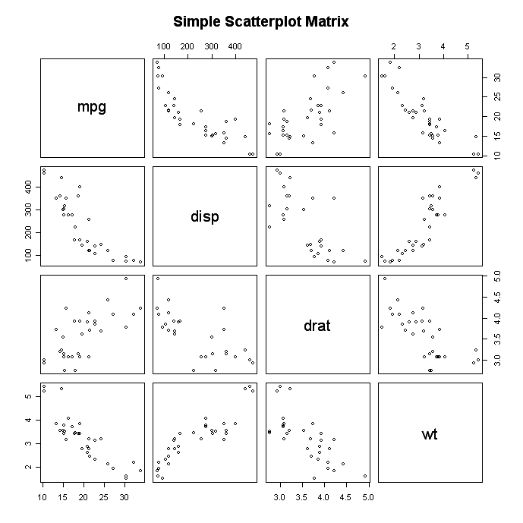
Cell proliferation
Time in culture
Cell size
Cell granularity

Slide 24
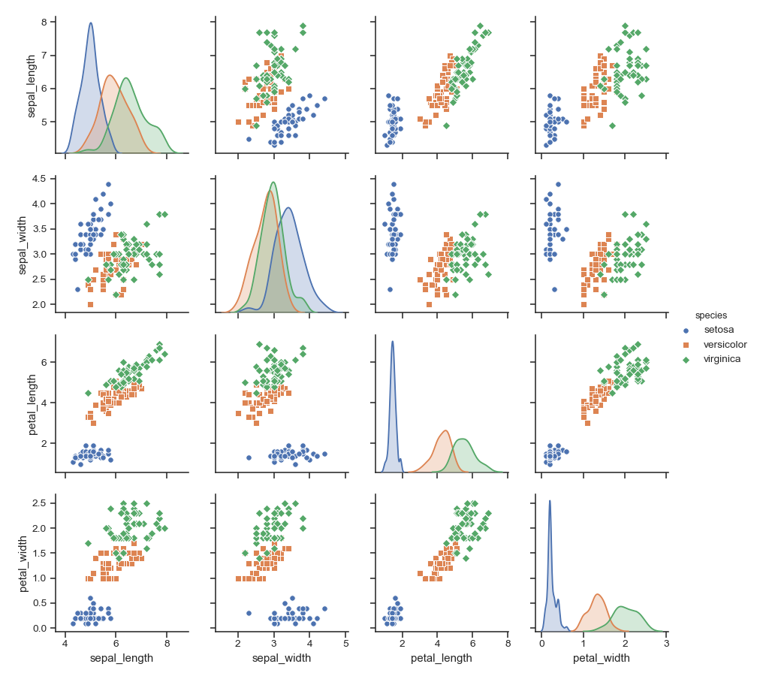

Slide 25
EDA is never inferential!

Slide 26
Diagnostic plots

Slide 27
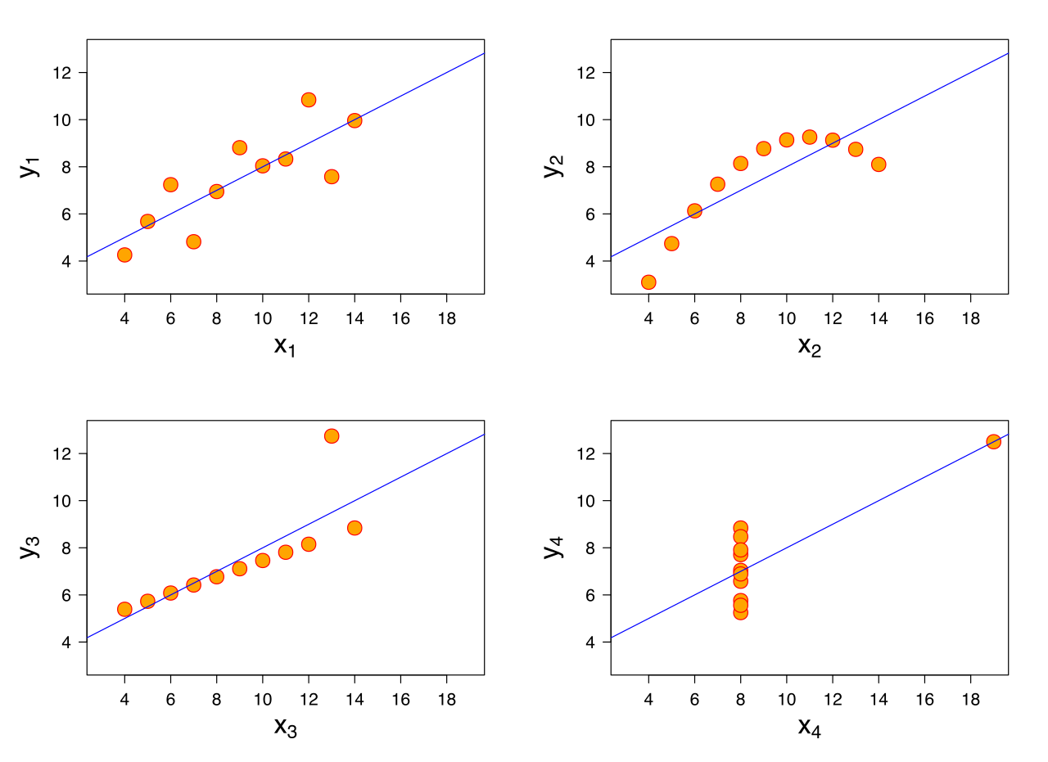
Anscombe’s quartet
“Graphs are essential to good statistical analysis”
Francis Anscombe, 1973

Slide 28
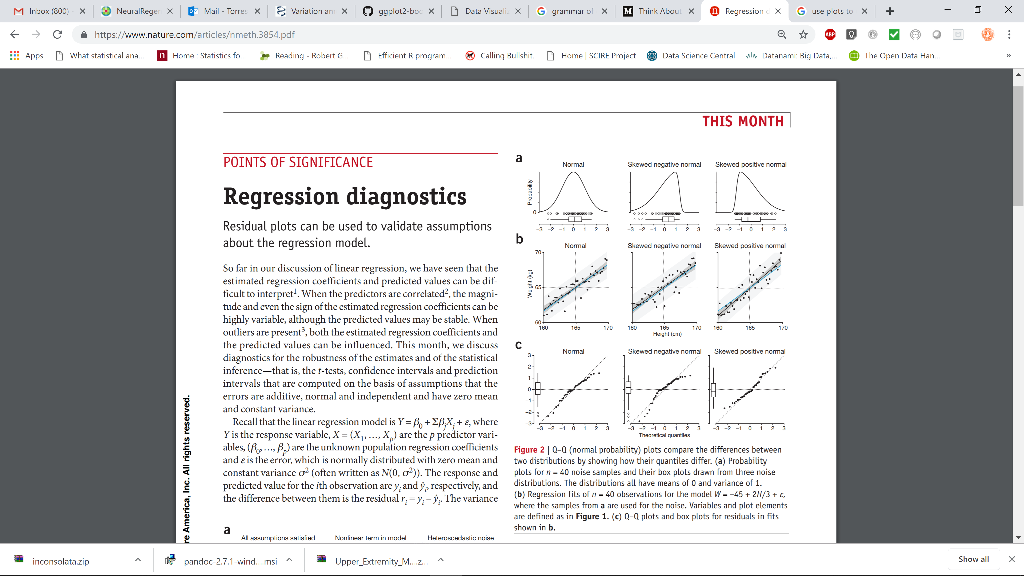
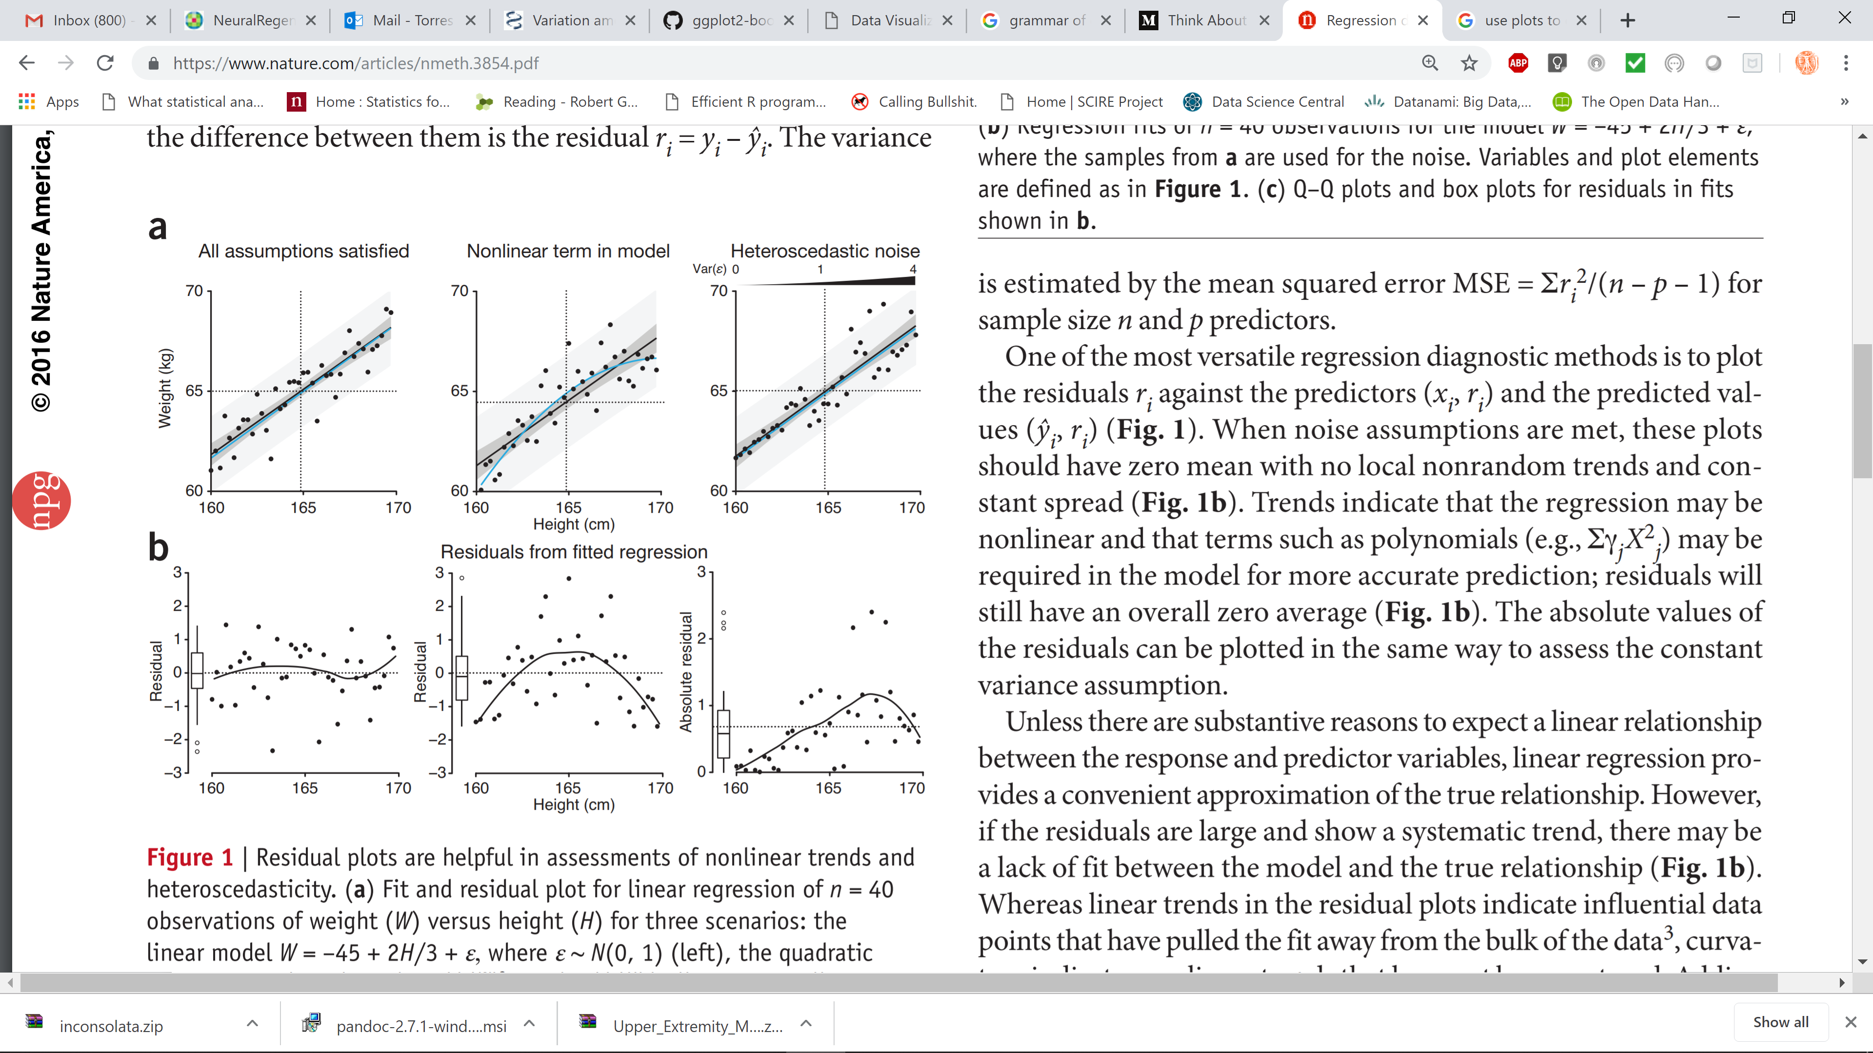
DataViz
Diagnostic plots
Assumptions of a linear regression
The real association between vars. is linear
The residuals (errors) are normally distributed
Homoscedasticity (equal variance)
Independence of observations

Slide 29

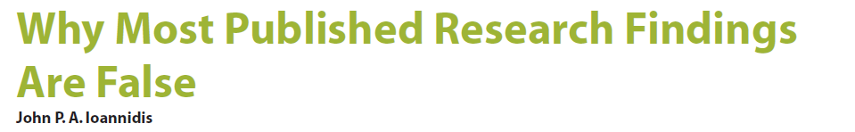
3. A recipe for reporting data effectively

Slide 30
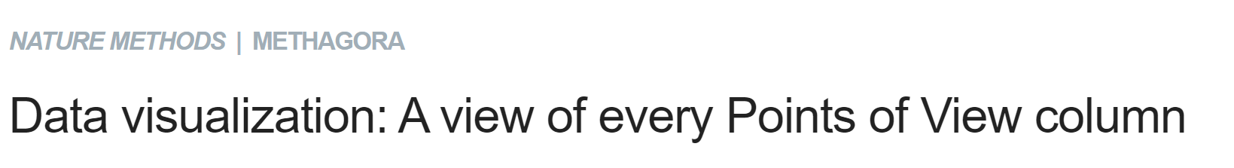
3. A recipe for reporting data effectively
http://blogs.nature.com/methagora/2013/07/data-visualization-points-of-view.html

Slide 31
3. A recipe for reporting data effectively
Choose the right tool: each data might have a graph type that best represents your message. Be thoughtful about what your visualization is telling
Proportionality: graphical elements should reflect the underline relationship of data
Perspective: graphs should allow for correct interpretation of the data
Clarity: use the minimal number of graphical elements to communicate the data
Consistency: use same visual components across graphs
Speak to your audience: e.g. avoid color schema difficult for color-blindness, use standards

Slide 32
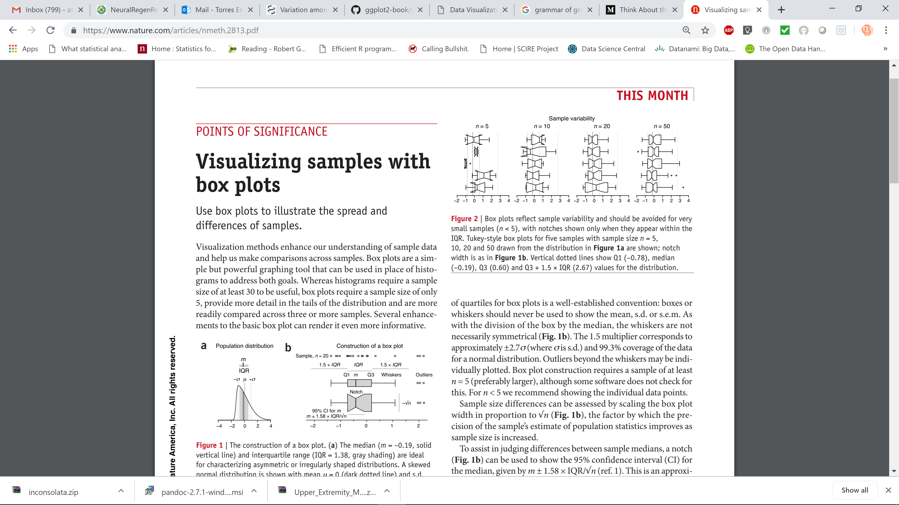
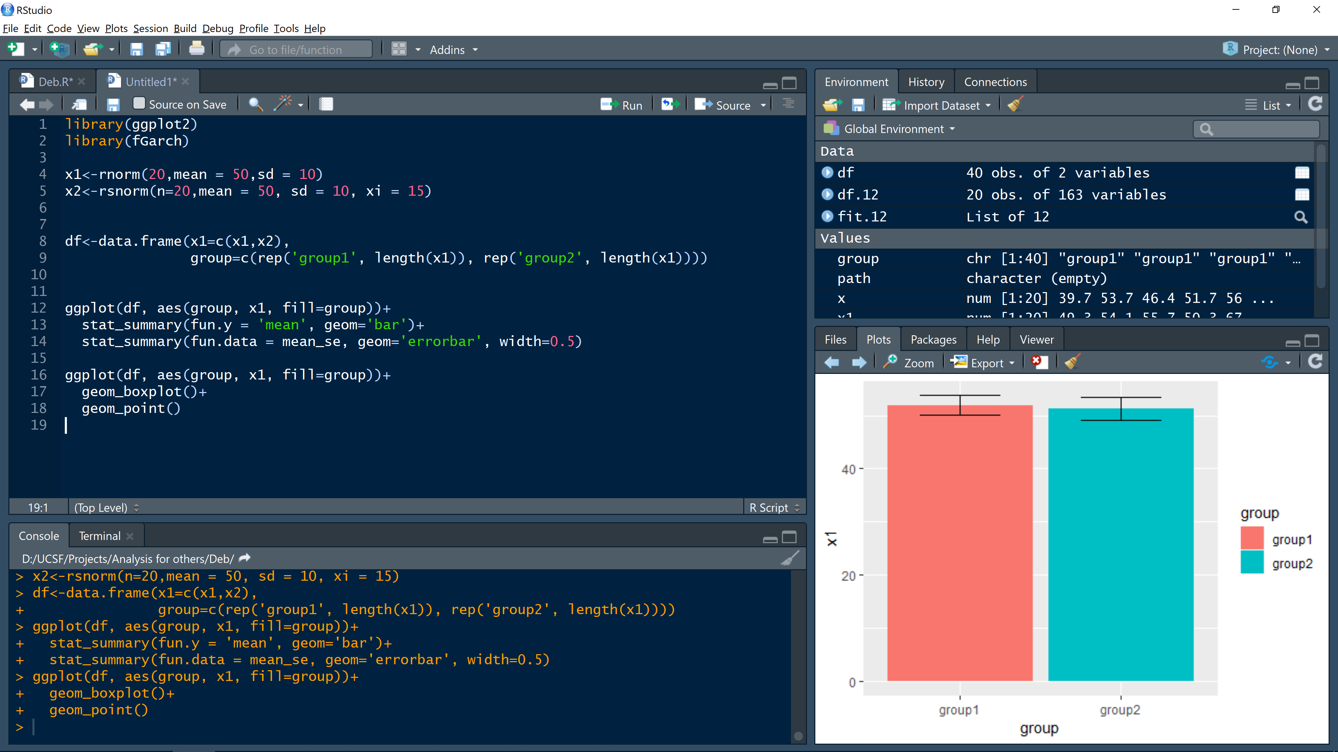

Slide 33
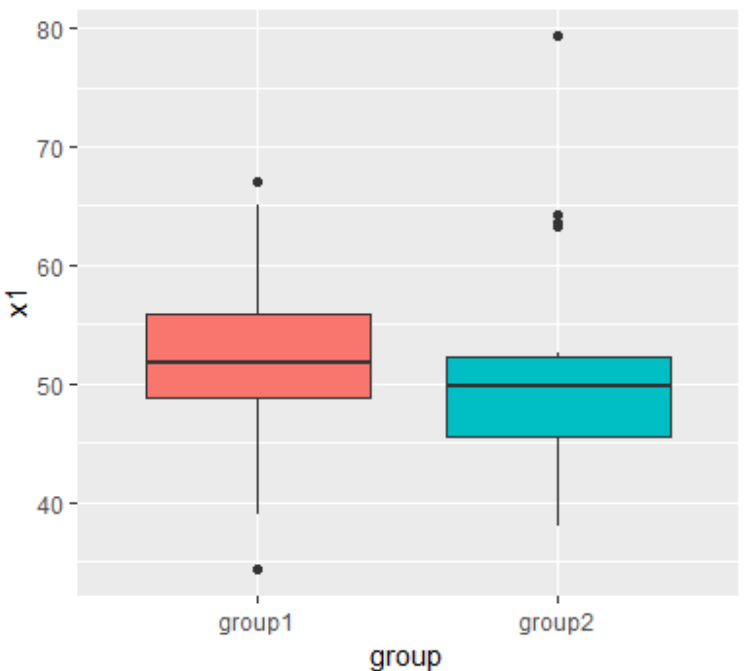

Slide 34
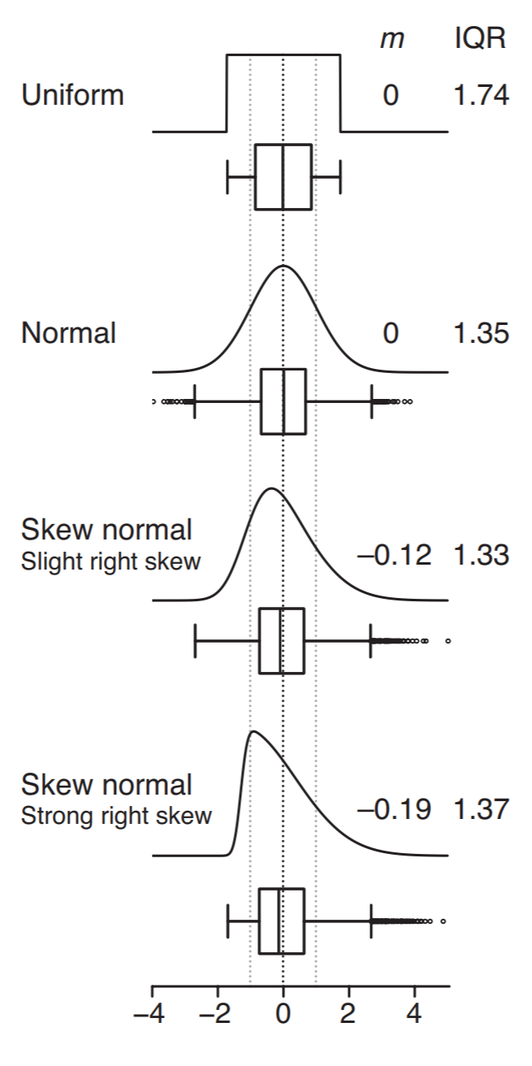

Slide 35
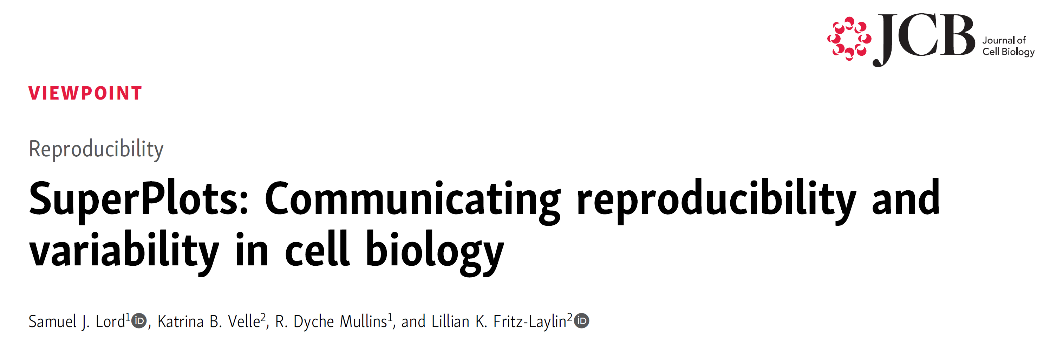
“In the case of treating each cell as an n, the assumption
that is violated is independent sampling, not necessarily the null hypothesis”

Slide 36
“In the case of treating each cell as an n, the assumption
that is violated is independent sampling, not necessarily the null hypothesis”
“Communicate both the cell-level variability and the
experimental reproducibility”

Slide 37
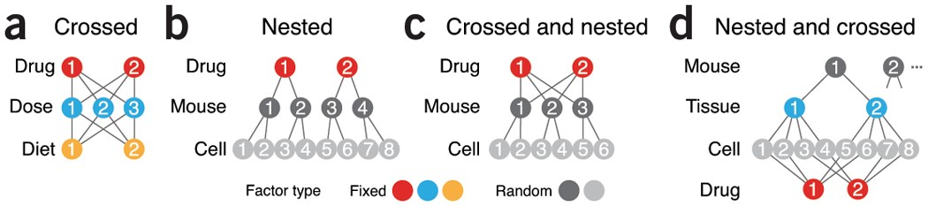

Slide 38
“For example, if a researcher measures the length of 20 neurons in a zebrafish and 20 neurons in a fish exposed to a toxin, the correct n for each condition is 1, because the toxin exposure was only performed once”

Slide 43
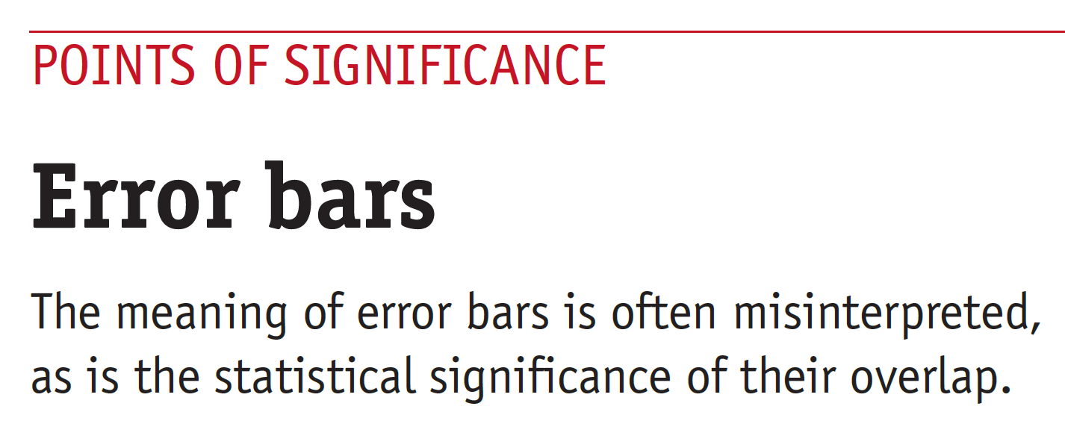
“The choice of error bars on a SuperPlot depends on what you hope to communicate: descriptive error bars characterize the distribution of measurements (e.g., standard deviation), while inferential error bars evaluate how likely it is that the same result would occur if the experiment were to be repeated (e.g., standard error of the mean or confidence intervals).”

Slide 44
What do I hope to convey?

Slide 45
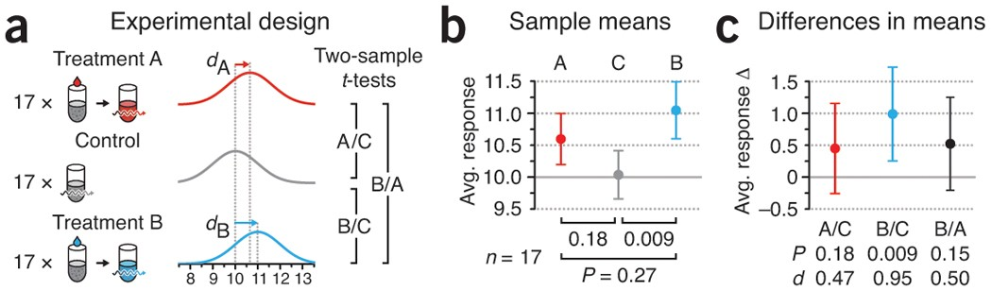

Slide 46
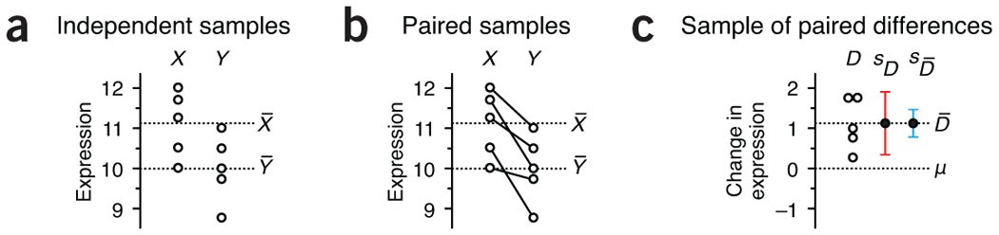

Slide 47
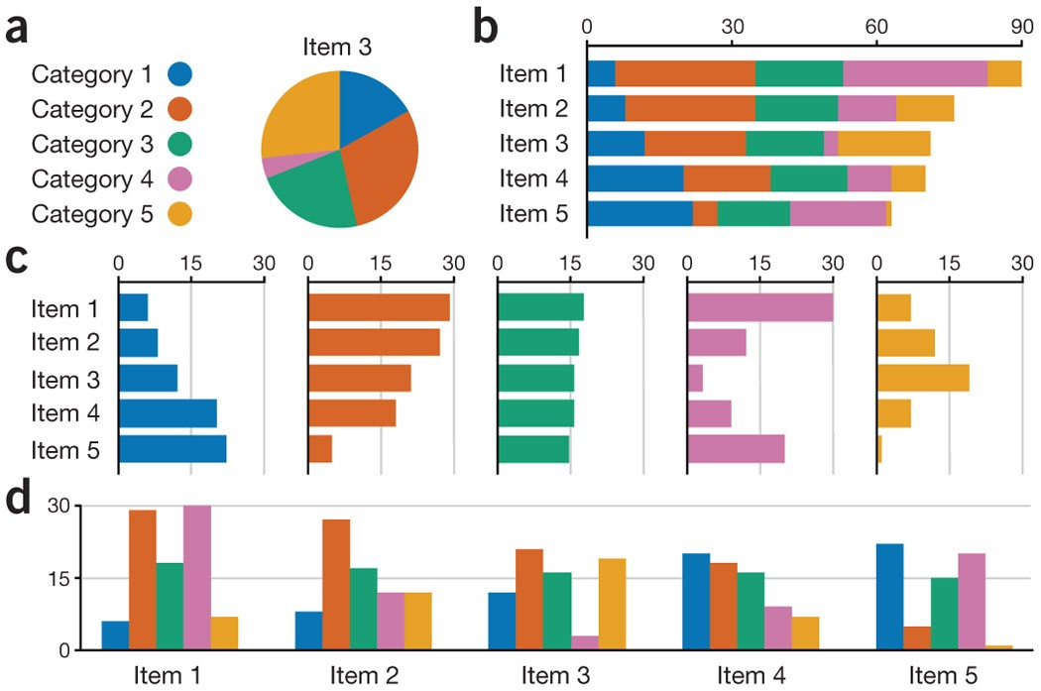
Choose the right tool:

Slide 48
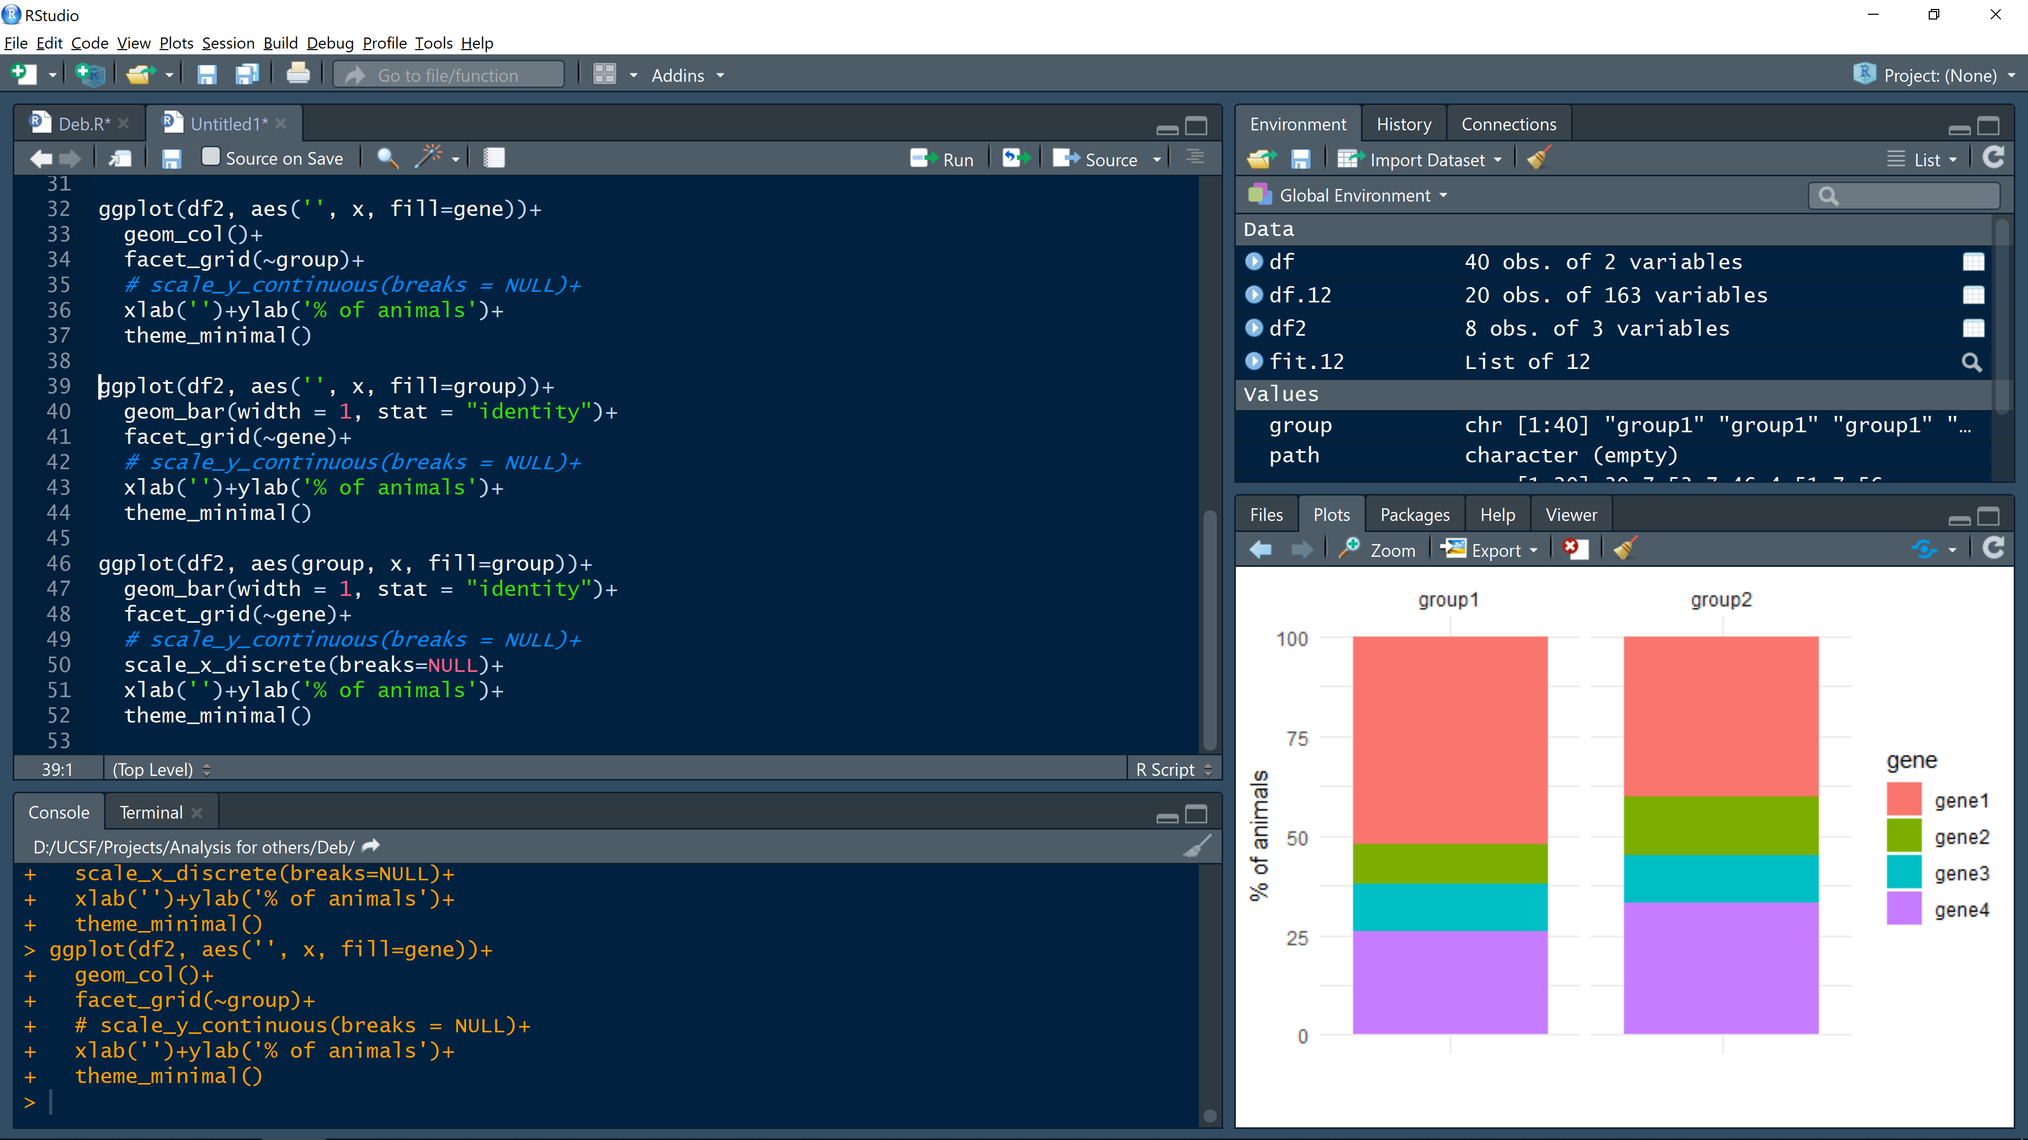
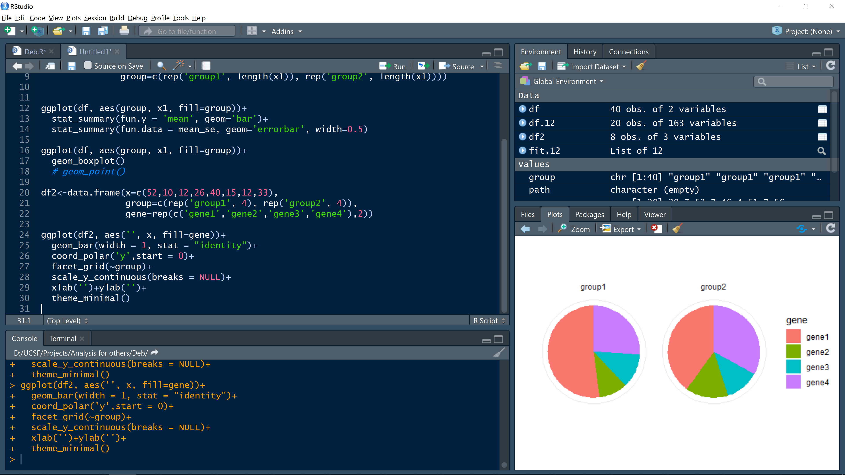
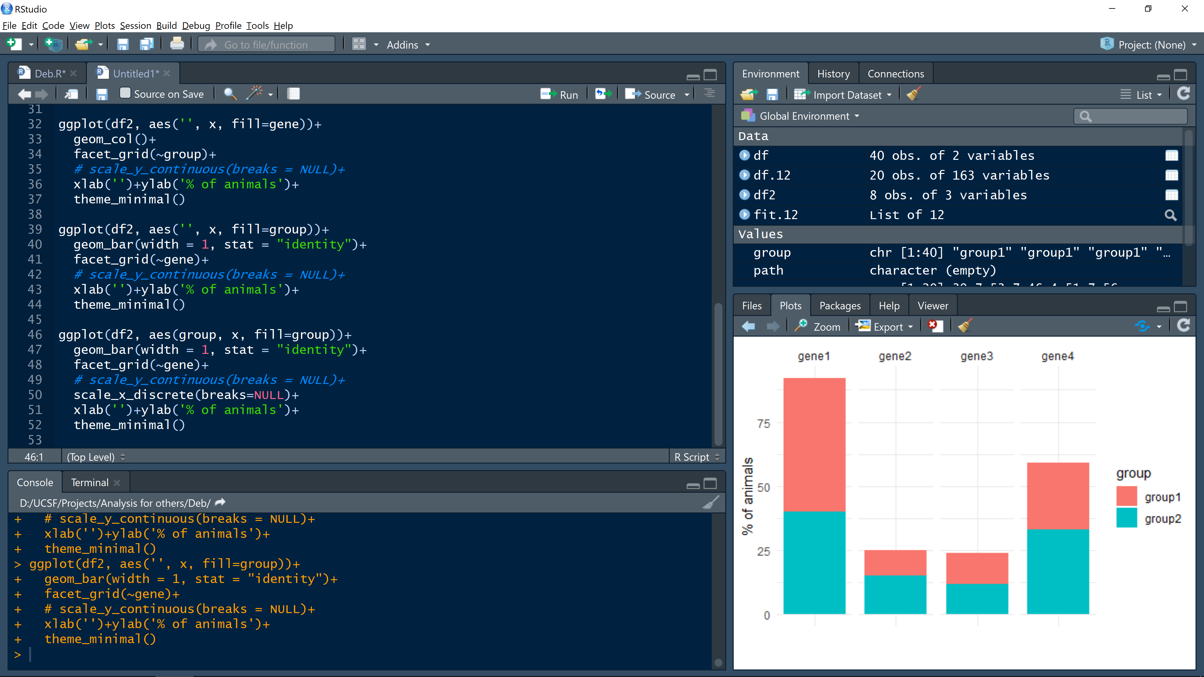
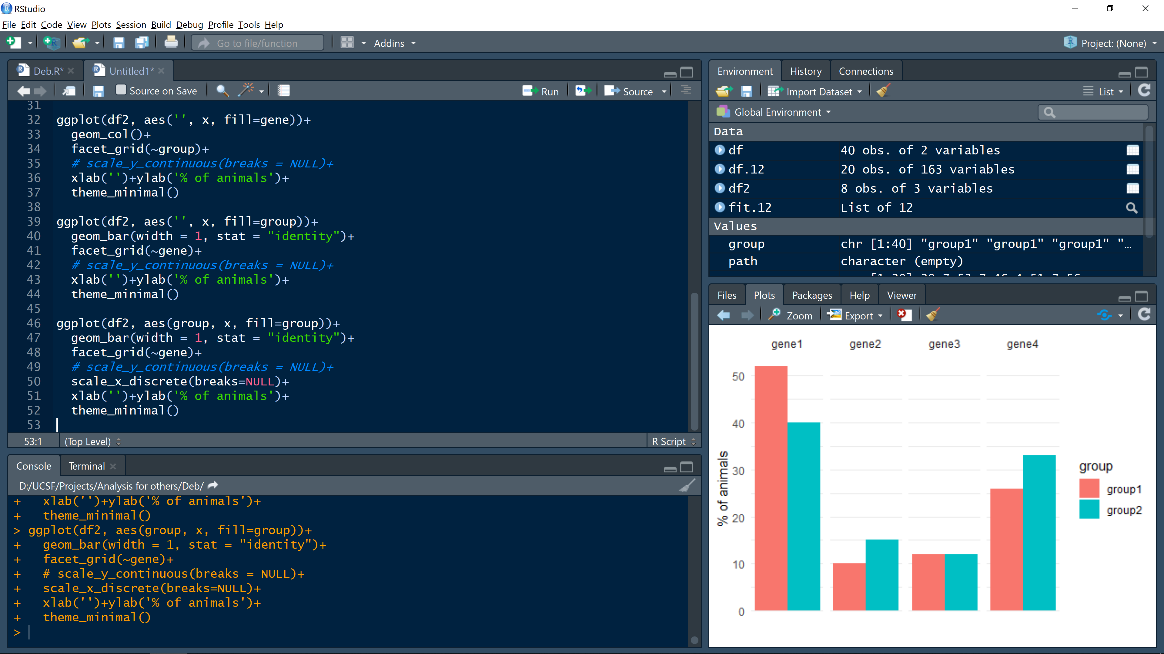
Choose the right tool:

Slide 49
3. A recipe for reporting data effectively
Choose the right tool: each data might have a graph type that best represents your message. Be thoughtful about what your visualization is telling
Proportionality: graphical elements should reflect the underline relationship of data
Perspective: graphs should allow for correct interpretation of the data
Clarity: use the minimal number of graphical elements to communicate the data
Consistency: use same visual components across graphs
Speak to your audience: e.g. avoid color schema difficult for color-blindness, use standards

Slide 50
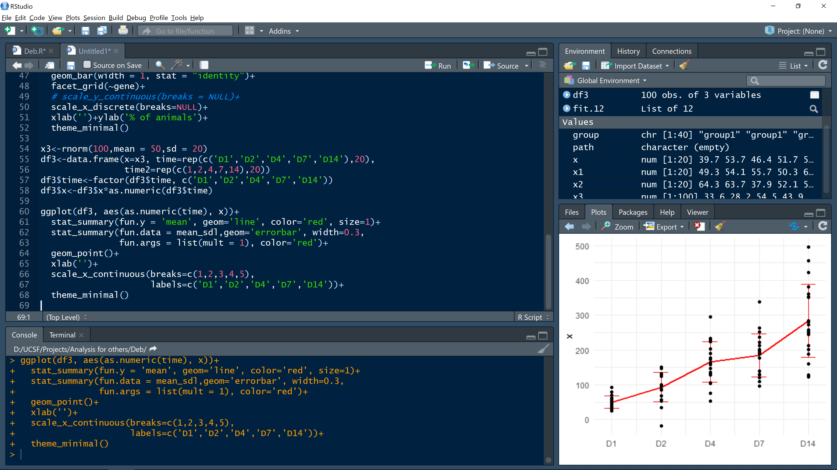
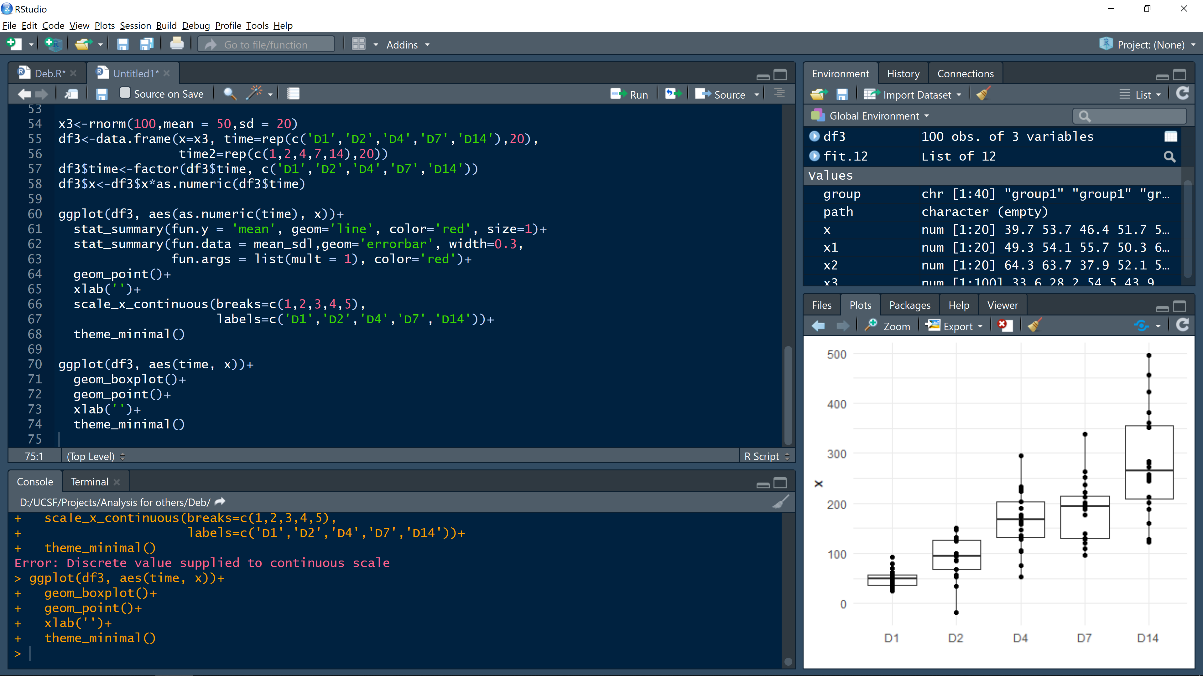
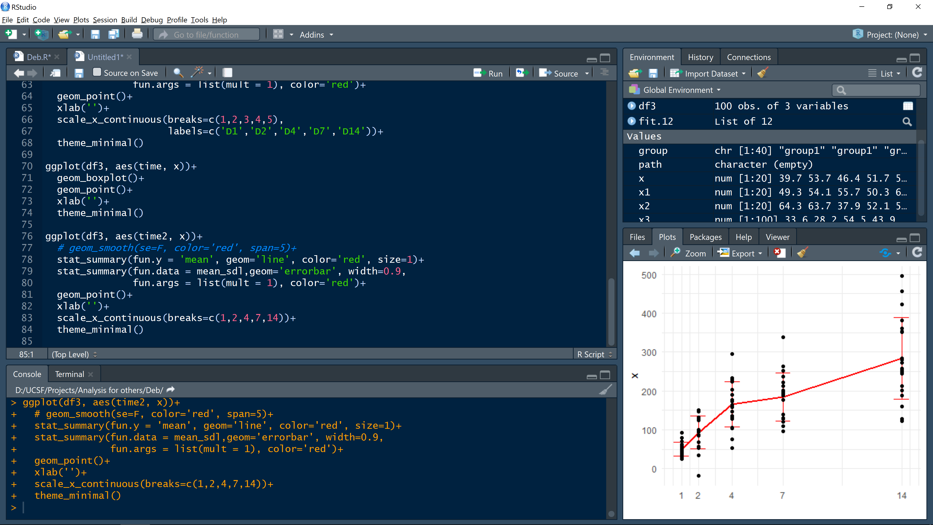
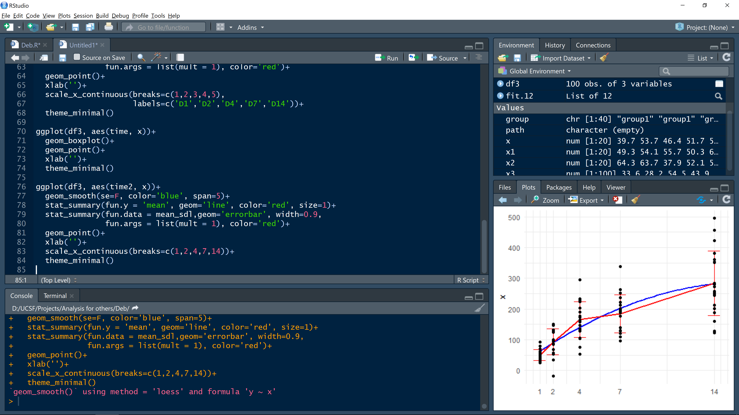

Slide 53
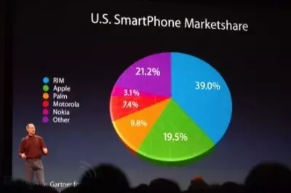

Slide 54
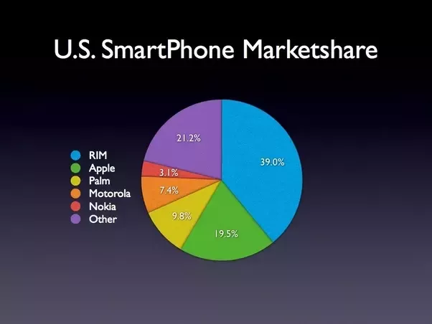
https://www.quora.com/What-should-everyone-know-about-making-good-charts-and-graphs-to-represent-data

Slide 55
3. A recipe for reporting data effectively
Choose the right tool: each data might have a graph type that best represents your message. Be thoughtful about what your visualization is telling
Proportionality: graphical elements should reflect the underline relationship of data
Perspective: graphs should allow for correct interpretation of the data
Clarity: use the minimal number of graphical elements to communicate the data
Consistency: use same visual components across graphs
Speak to your audience: e.g. avoid color schema difficult for color-blindness, use standards

Slide 56
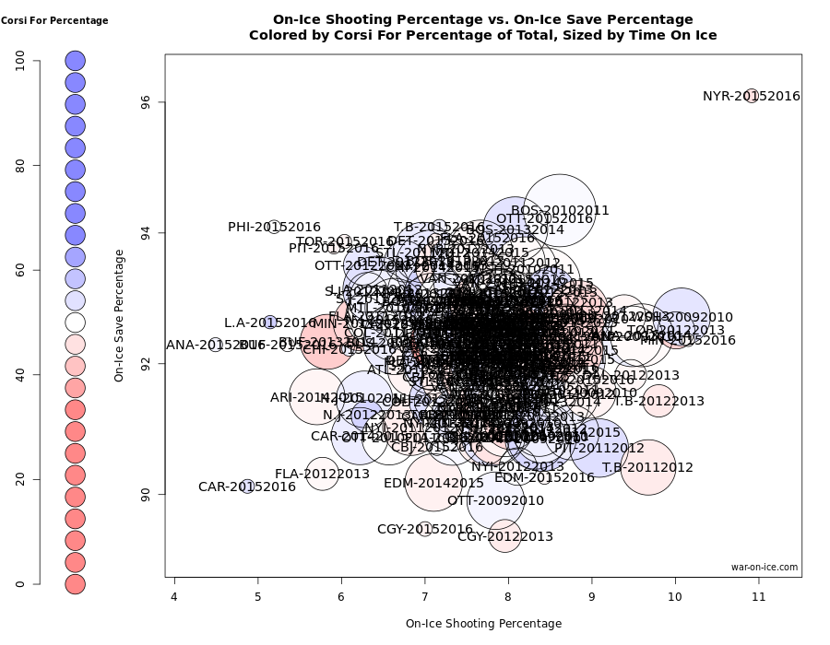
http://bcuchta.com/wall_of_shame/

Slide 57
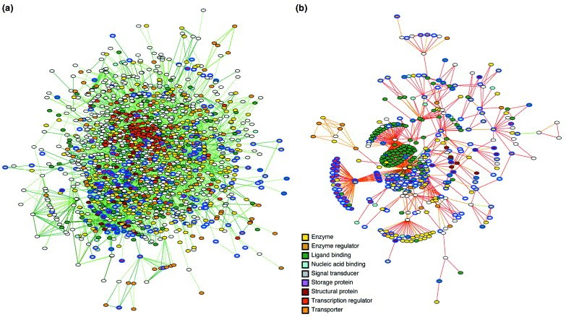
https://abucketfullofscience.wordpress.com/2016/04/12/bad-bad-science-figures/

Slide 58
Less is more: the data-ink ratio
Edward Tufte
The Visual Display of Quantitative Information

Slide 59
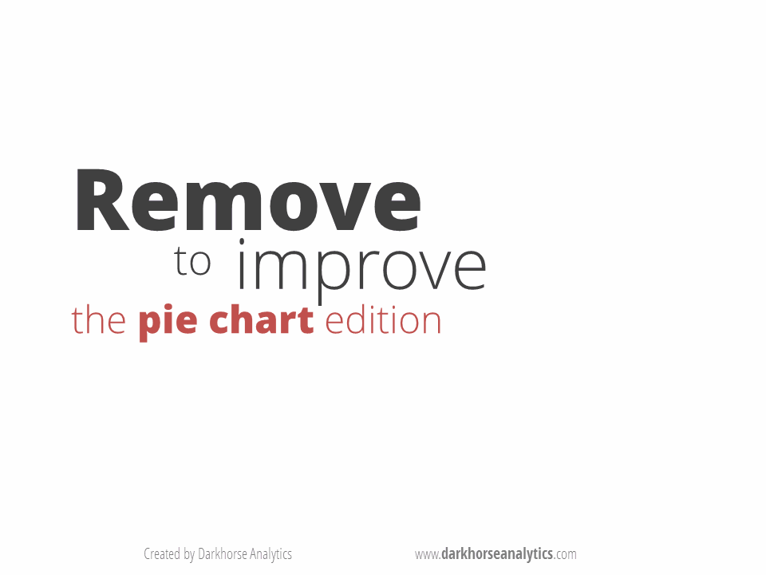
Less is more: the data-ink ratio
https://www.darkhorseanalytics.com/blog/salvaging-the-pie

Slide 60
3. A recipe for reporting data effectively
Choose the right tool: each data might have a graph type that best represents your message. Be thoughtful about what your visualization is telling
Proportionality: graphical elements should reflect the underline relationship of data
Perspective: graphs should allow for correct interpretation of the data
Clarity: use the minimal number of graphical elements to communicate the data
Consistency: use same visual components across graphs
Speak to your audience: e.g. avoid color schema difficult for color-blindness, use standards

Slide 61
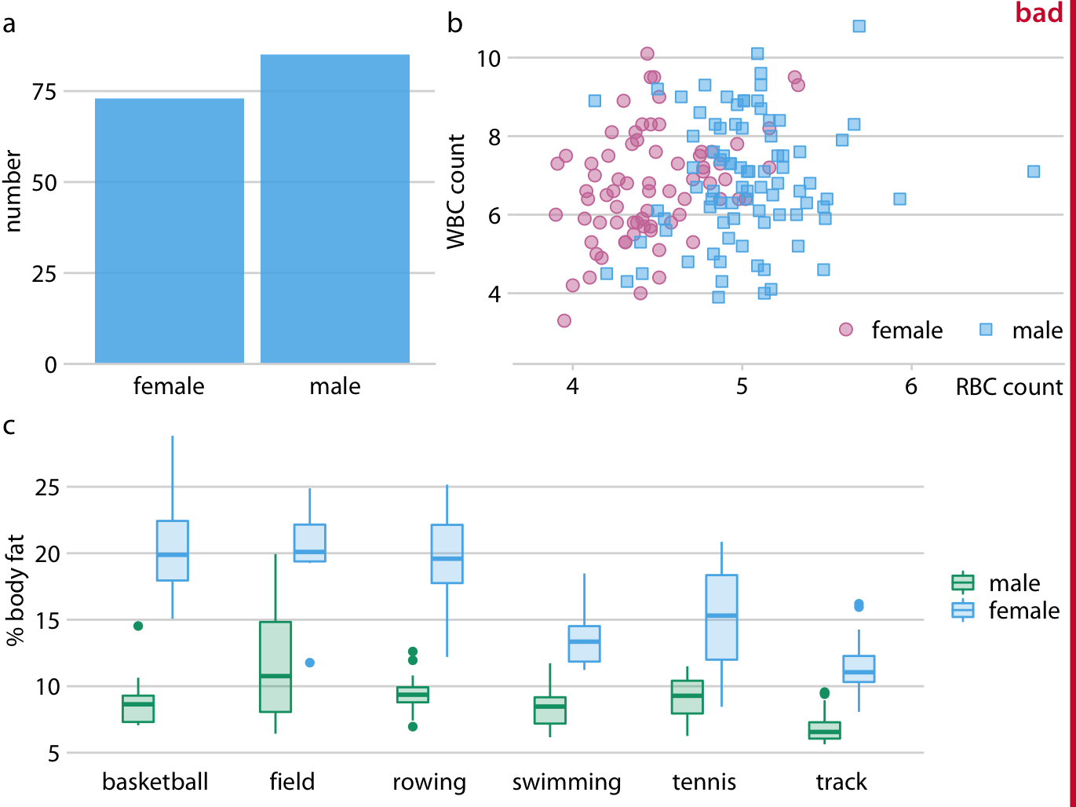
https://serialmentor.com/dataviz/multi-panel-figures.html

Slide 62
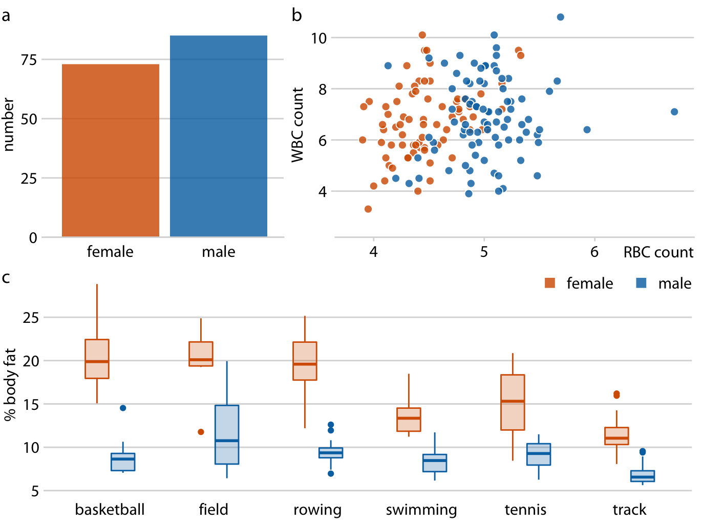
https://serialmentor.com/dataviz/multi-panel-figures.html

Slide 63
3. A recipe for reporting data effectively
Choose the right tool: each data might have a graph type that best represents your message. Be thoughtful about what your visualization is telling
Proportionality: graphical elements should reflect the underline relationship of data
Perspective: graphs should allow for correct interpretation of the data
Clarity: use the minimal number of graphical elements to communicate the data
Consistency: use same visual components across graphs
Speak to your audience: e.g. avoid color schema difficult for color-blindness, use standards

Slide 64
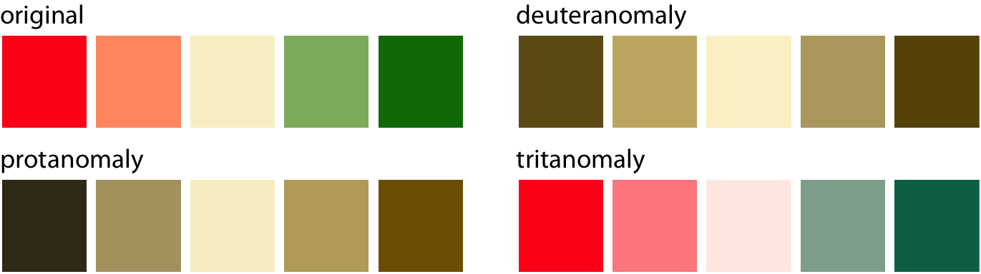
https://serialmentor.com/dataviz/redundant-coding.html
https://www.canvasflip.com/color-blind.php
https://bconnelly.net/posts/creating_colorblind-friendly_figures/

Slide 65
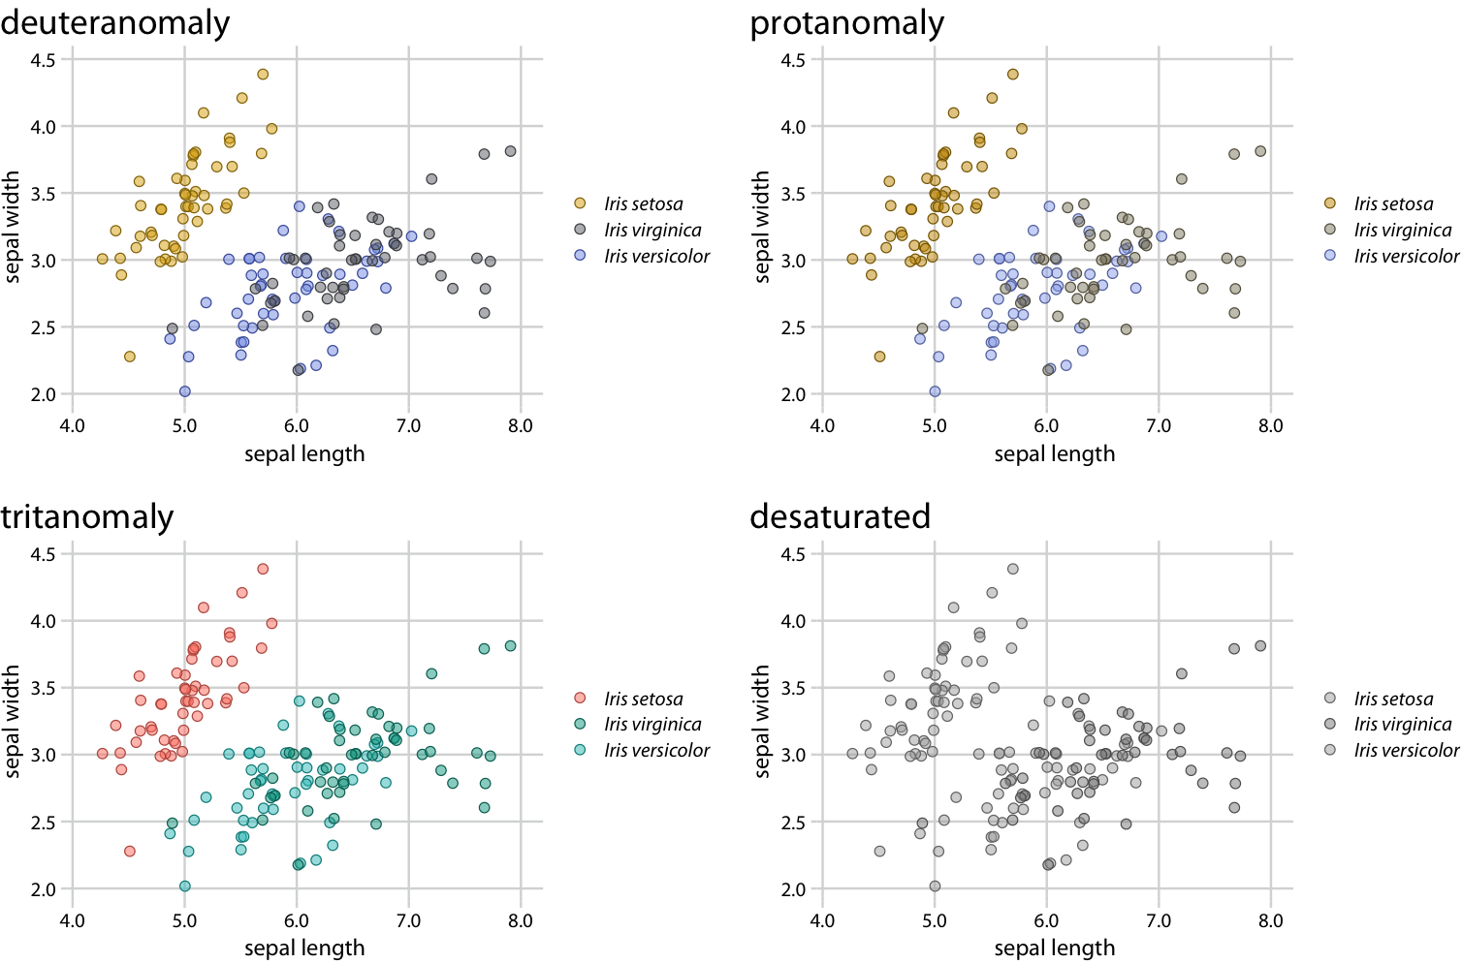
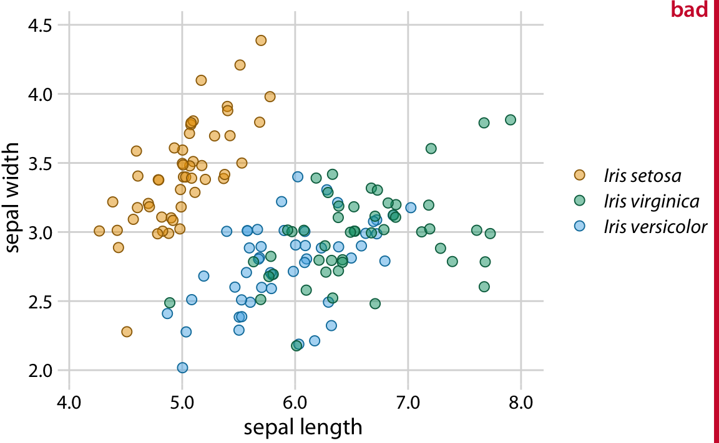
https://serialmentor.com/dataviz/redundant-coding.html

Slide 66
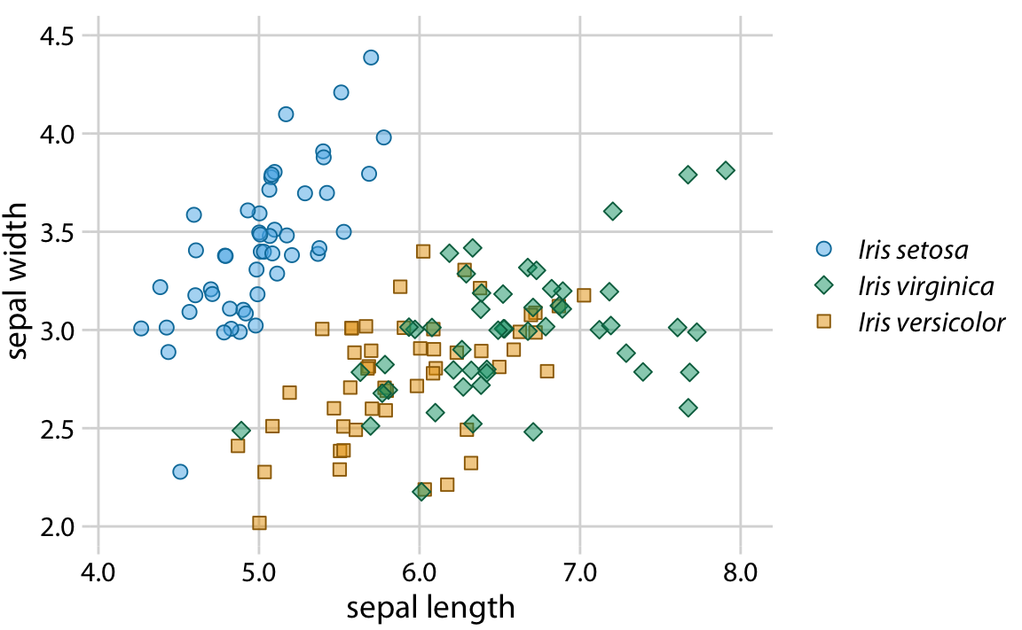
https://serialmentor.com/dataviz/redundant-coding.html

Slide 67
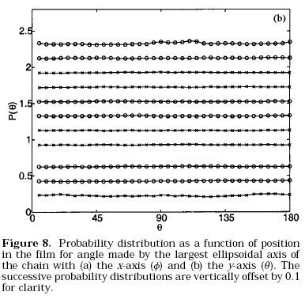
DataViz
Be useful!

Slide 68
DataViz
LET’S PLOT!

Slide 69
DataViz
4. The grammar of graphics and ggplot2
Created by Leland Wilkinson in 2005 as a framework for statistical plotting that describes the elements of any graph. Thus, graphs are made of the combination of individual elements:
Data: no data, no plot!
Aesthetics: the scales in which the data is mapped (x, y axis, color, shape…)
Geometry: shapes to represent the data (bars, lines, points, etc.)
Facets: split your plot by variables
Statistics: summarize and aggregate data (mean and margin of error, etc.)
Coordinates: the plotting space
Theme: describes the visual aspect of the different elements in the graph.
Implemented in R in the ggplot2 package
https://github.com/hadley/ggplot2-book/

Slide 70
DataViz
Bad Graph Wall of Shame
http://bcuchta.com/wall_of_shame/
The top ten worst graphs
https://www.biostat.wisc.edu/~kbroman/topten_worstgraphs/
Data is ugly
https://www.reddit.com/r/dataisugly/
Data is beautiful
https://www.reddit.com/r/dataisbeautiful/

Slide 71
DataViz
Fundamentals of Data Visualization:
https://serialmentor.com/dataviz/
ggplot2:
https://github.com/hadley/ggplot2-book/
Introduction to data science:
https://rafalab.github.io/dsbook/

